Slide 1




Period Poverty in Correctional Facilities >> Managing a Period While Incarcerated >> Menstrual Equity in Correctional Facilities >> Take Action
Periods in Prison
A 4-Part Workshop about Period Poverty and Menstrual Equity in U.S. Correctional Facilities

Slide 2


PERIOD. is a global youth-fueled nonprofit with over 400 youth led chapters working to eradicate period poverty and stigma through service, education, and advocacy.
PERIOD. annually distributes millions of menstrual products to grassroots organizations serving their communities in need, authors stigma-busting menstrual health curriculum, and equips young leaders to advocate for menstrual equity policies such as the repeal of the tampon tax and mandating period products in public places.
www.period.org | @periodmovement
2

Slide 3
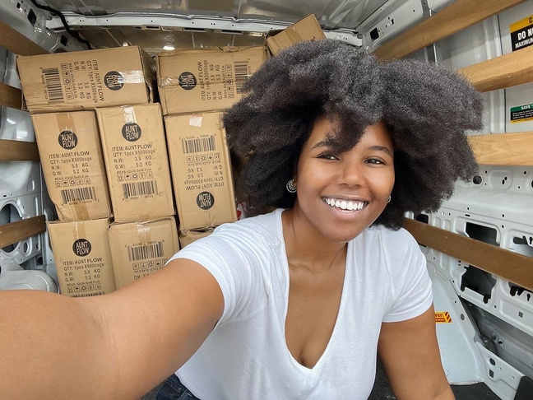
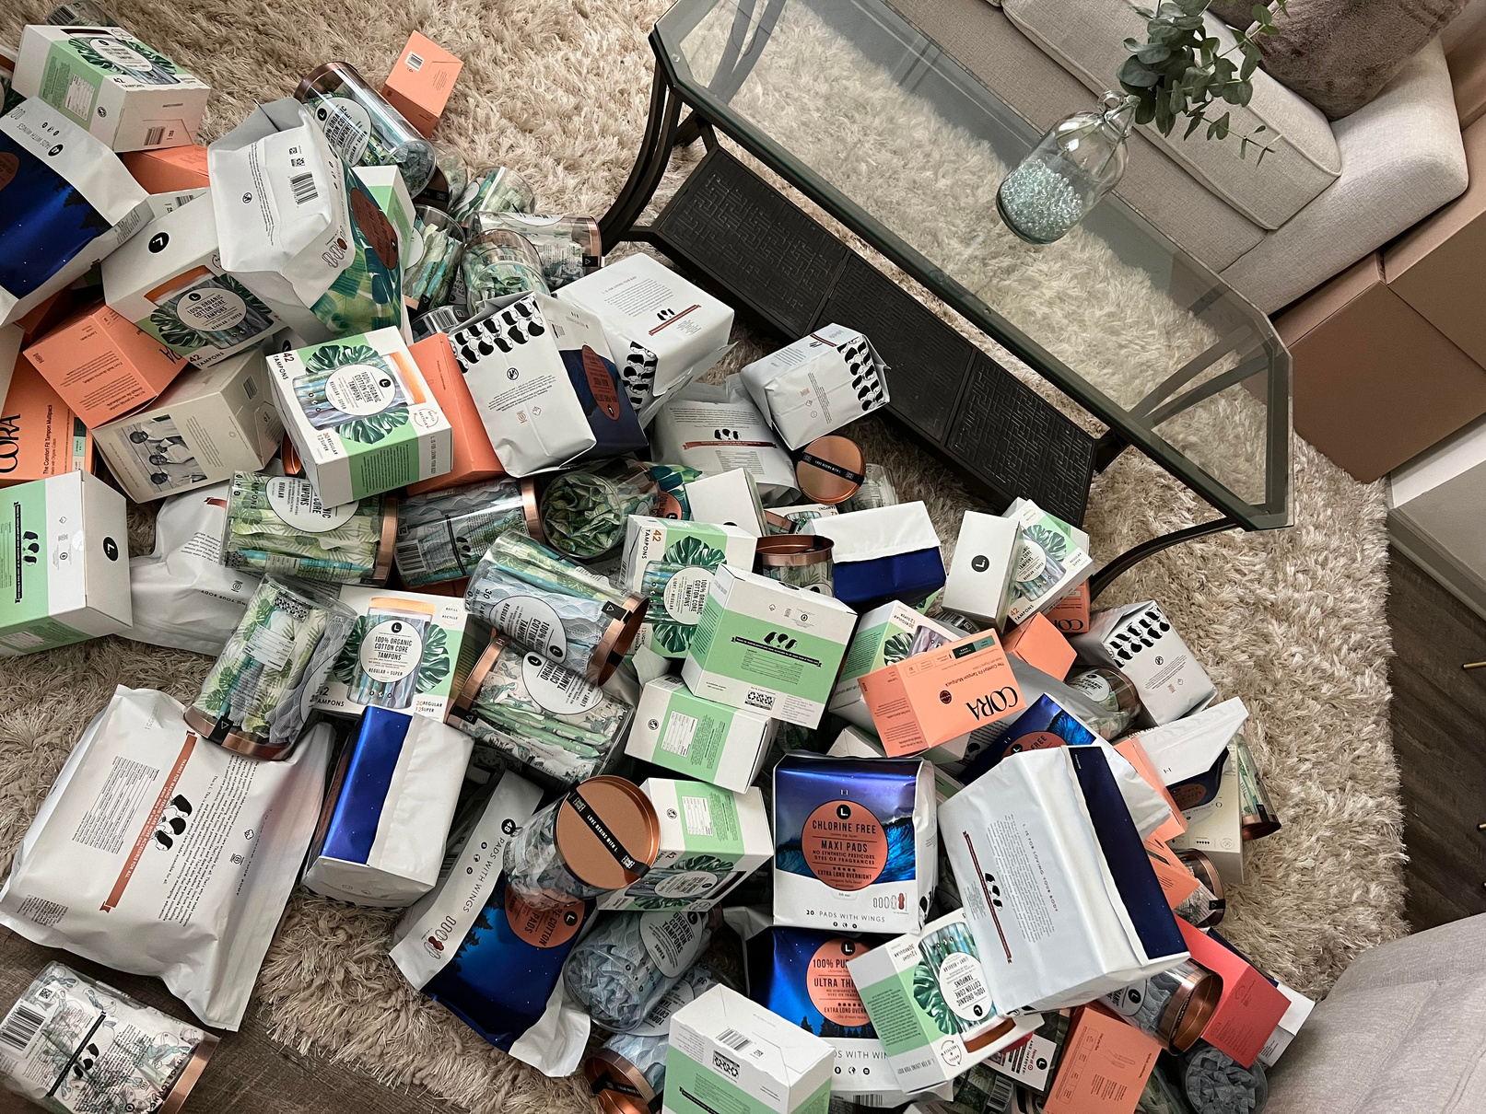
THE THURMAN PERRY FOUNDATION
The Thurman Perry Foundation is an award winning Louisiana-based nonprofit operating nationally with a mission of offering scholarships, essential healthcare resources, and housing relief to at least 10,000 women & girls impacted by incarceration by 2030.
Founded in 2021 by formerly incarcerated woman turned epidemiologist, Gabrielle A. Perry, MPH, The Thurman Perry Foundation is named in memory of Ms. Perry’s father, U.S. Army Master Sergeant Thurman Perry Jr.
The Thurman Perry Foundation’s Girl Code initiative stands alone nationally as the only public health program for incarcerated women to promote menstrual equity and eliminate period poverty by donating organic, cotton, chlorine-free, dye-free, and fragrance-free menstrual products.
TPF’s Girl Code initiative has endorsed federal legislation to mandate the sufficient provision of menstrual products to incarcerated women and girls in state, local, and juvenile correctional facilities, and, in 2 years, has donated almost 200,000 organic menstrual products to 4,435 incarcerated women in correctional facilities throughout Louisiana, Texas, and New York state.
By 2026, The Thurman Perry Foundation has pledged to donate 1 million menstrual products to system-impacted women and girls to foster both health and safety for incarcerated women.
ThurmanPerryFoundation.org | @ThurmanPerryFoundation
3

Slide 4

Period Poverty in Correctional Facilities >> Managing a Period While Incarcerated >> Menstrual Equity in Correctional Facilities >> Take Action
Periods in Prisons:
This workshop is divided into four parts and appendices with additional resources
  PART 1: Period Poverty and Correctional Facilities.................... 7
  PART 2: Managing a Period While Incarcerated.........................21
  PART 3: Menstrual Equity in Correctional Facilities...................50
  PART 4: Ways to Take Action..............................................................66
  A: Carceral Debt................................73
  B: Policy Recomendations.............74
  C: References.....................................76
  D: Additional Readings....................81
APPENDICES:
4

Slide 5

Thank you for taking the time to learn more about periods in prisons. Let’s jump right in.
INTRODUCTIONS & OPENING REFLECTIONS
What do you think it’s like to manage a period without any access to period products?
What do you think it’s like to have to manage a period while incarcerated?
5

Slide 6


Period Poverty in Correctional Facilities >> Managing a Period While Incarcerated >> Menstrual Equity in Correctional Facilities >> Take Action
“Women and girls have been the fastest-growing group of incarcerated people in the United States, and the number of women serving sentences of life without parole has grown by 43% since 2008.
These women are mothers, sisters, daughters and friends. They are people who deserve dignity.”
- Gabrielle A. Perry
Executive Director, The Thurman Perry Foundation
“Opinion: In prison, having your period can put your life in danger.” The Washington Post
1
2
3
6

Slide 7

Part 1: Period Poverty and Correctional Facilities
What is Period Poverty?
7

Slide 8






Part 1: Period Poverty and Correctional Facilities
On any given day,
4
800 MILLION PEOPLE
on the planet are menstruating.
Managing a period requires resources like:
Safe Places
to Throw
Away Waste
Period Products
Menstrual Health Education
Clean Water
& Soap
Safe & Private
Restrooms
8

Slide 9
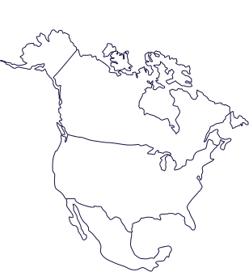
Part 1: Period Poverty and Correctional Facilities
Yet, at least
500 MILLION PEOPLE
don’t have the adequate resources to manage their period every month.
That's more people than everyone living in Canada, the U.S. and Mexico combined!
5
9

Slide 10
Part 1: Period Poverty and Correctional Facilities
PERIOD POVERTY:
The limited or inadequate access to menstrual products or menstrual health education due to financial constraints or negative stigma around menstruation.
6
10

Slide 11
Part 1: Period Poverty and Correctional Facilities
PERIOD POVERTY IN THE GENERAL U.S. POPULATION
Nearly 1 in 4 students have struggled to afford period products, or were not able to purchase them at all.
7
More than 2 in 5 people who menstruate have struggled to purchase period products due to lack of income at some point in their life.
8
Nearly 1 in 10 college students experience period poverty every month, with Black and Latinx students being disproportionately affected compared to white students.
9
PERIOD POVERTY EXISTS AT THE INTERSECTION OF
ECONOMIC, GENDER, AND RACIAL INEQUAL﻿ITY.
11

Slide 12
Who is impacted by period poverty in U.S. CORRECTIONAL FACILITIES?
Part 1: Period Poverty and Correctional Facilities
12

Slide 13
Part 1: Period Poverty and Correctional Facilities
CORRECTIONAL FACILITY:
Jail, prison, or other detention facility used to house people who have been arrested, held, or convicted by a criminal justice agency or court.
“Correctional Facilities” will be used throughout this presentation when referring to all facility types that house people who are incarcerated.
10
13

Slide 14

Part 1: Period Poverty and Correctional Facilities
DID YOU KNOW? FACTS ABOUT WOMEN AND INCARCERATION
The United States has the highest incarceration rate of any country in the world with nearly two million people behind bars.
11
Women are the fastest growing group of incarcerated people in the United States.
1
525%
Between 1980 and 2021, the number of incarcerated women in the United States increased by more than
12
Despite this historic rise, correctional facilities have often failed to consider unique needs of people who menstruate while incarcerated.
13
14

Slide 15
Part 1: Period Poverty and U.S. Correctional Facilities
A Quick Note on Language: “WomEn” and “MenstrUAtor”
It is common for statistics to be coded as data about ‘women.’
When referencing data, the terms used in the original data source will be used to accurately reflect the reference.
When referring to the general needs of people who menstruate, the term ‘menstruator’ may be used as an inclusive term to include women, girls, and all people who menstruate, to include trans, non-binary, and intersex people who can also menstruate while incarcerated.
Learn more about the term “Menstruator,” along with additional terms used throughout this presentation in PERIOD. and Madami’s Glossary for the Global Menstrual Movement.
41
15

Slide 16

Part 1: Period Poverty and U.S. Correctional Facilities
WHERE ARE WOMEN INCARCERATED IN THE UNITED STATES?
The United States has created a carceral system that includes multiple forms of incarceration and surveillance.
14
Number of Women
Parole
Probation
Detention Centers
the majority of incarcerated women are in local jails and state prisons, given the nature of convictions for the majority of women are typically nonviolent.
Local Jails
State Prisons
15
Federal Prisons
0
250,000
500,000
750,000
When considering policies and regulations, it’s important to consider
where people who menstruate are incarcerated.
16

Slide 17
Part 1: Period Poverty and Correctional Facilities
WHERE ARE WOMEN INCARCERATED IN THE UNITED STATES?
16
17
Detention Centers
Local Jail
  Temporarily house and rehabilitate people who have been accused of breaking a law.
  Sometimes used to hold individuals awaiting trial or sentencing.
Examples include:
  Military Installation Detention
  Tribal Detention
  Juvenile Detention
  Immigration and Customs Enforcement (ICE) Detention
  Institutional local facilities governed by the city, local district, or county
  Jails are typically short-term holding facilities for the newly arrested and those awaiting trial or sentencing.
  Individuals sentenced to serve a small amount of time, typically less than a year
  Also referred as “City jail.”
  More than 1 in 6 jail releases in the United States are women.
45
17

Slide 18

Part 1: Period Poverty and Correctional Facilities
PRISON type | State Prison | Federal Prison
Institutional facilities governed by: | State Government Decisions made at the state level impact people solely in that state. For example, California, Louisiana, or Texas. | Federal Government The highest level of national governance in the United States. Decisions made at the federal level impact people in the entire country, not just people of the individual state.
Convicted of: | Violating a state law | Violating a federal law
Typical Sentences: | Typically for serving longer sentences, usually 1+ years | Typically for serving longer sentences, usually 1+ years
17
About 1 in 8 individuals released from U.S. State prisons are women.
45
18

Slide 19
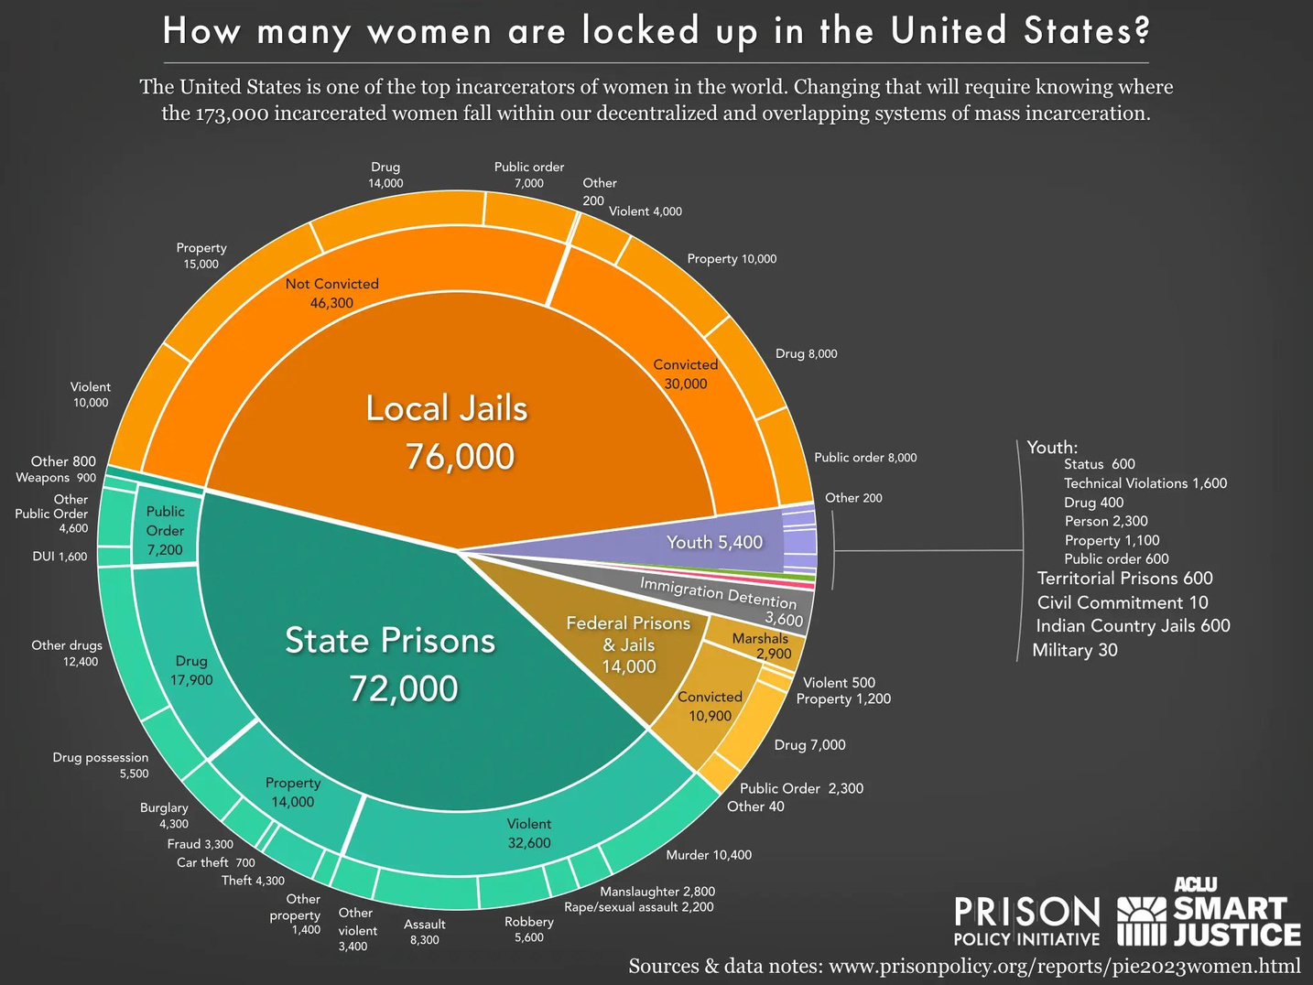
Part 1: Period Poverty and U.S. Correctional Facilities
THERE ARE ABOUT 173,000 WOMEN INCARCERATED IN THE UNITED STATES
RIGHT NOW.
WHY AND WHERE ARE THEY INCARCERATED?
15
Image Source:
Prison Policy Initiative, 2023
19

Slide 20
REFLECTION QUESTIONS
What, if anything, stood out to you from our discussion so far?
What are some differences between detention centers, local jails and prisons?
20

Slide 21

Part 2: Managing a Period While Incarcerated
GEneral LIMITATIONS that impact incarcerated people who menstruate
21

Slide 22

Part 2: Managing a Period While Incarcerated
“The carceral system was not developed with women in mind.”
- Cynthia Roseberry
Acting Director, ACLU Justice Division
American Civil Liberties Union
18
22

Slide 23




Part 2: Managing a Period While Incarcerated
There are multiple
limitations for people who are incarcerated
that impact the experiences of people who menstruate, including:
General Security Regulations
Period Stigma
and Shame
Limited, or no access,
to preventative health care
Limited or no access to quality and sufficient period products
Limitations and regulations vary by correctional facility, and impact people’s individual experience differently with managing their period while incarcerated.
23

Slide 24

Part 2: Managing a Period While Incarcerated
General Security Regulations that impact incarcerated people who menstruate
No Sharing of Menstrual Products
  In some cases, sharing menstrual products purchased from the commissary can be considered “bartering”
  Bartering is illegal behind bars and can result in additional time added to a sentence.
No Free Bleeding
  In some cases, “Free bleeding” onto prison issued clothing repeatedly due to lack of menstrual products can be considered “destruction of prison property.”
  Destruction of prison property is illegal behind bars and can result in additional time added onto a sentence.
24

Slide 25
Part 2: Managing a Period While Incarcerated
General Security Regulations that impact incarcerated people who menstruate
Showers and Laundry Limitations
  Certain facilities do not allow incarcerated people to bathe with regularity. Showers are often limited to less than 5 mins
  Limited access to laundry facilities, leading to difficulties in washing period-stained uniforms, bedding, or underwear
  Individuals may be forced to carry period-stained uniforms or underwear in a clear bag, which causes humiliation and shame.
19
25

Slide 26
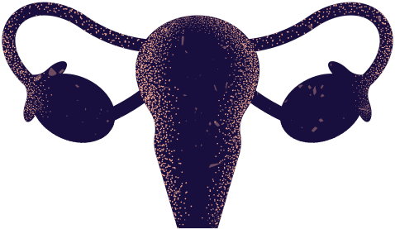
Part 2: Managing a Period While Incarcerated
people who are incarcerated also experience PERIOD STIGMA AND SHAME
As with the general population, period stigma and lack of
menstrual health education is also pervasive in correctional facilities.
Often raised by former inmates, incarcerated
menstruators may pass down outdated old wives
tales with limited understanding of how to
adequately manage their period.
People, guards, correctional authorities, and elected officials are often embarrassed or ashamed to talk about periods, ignoring the menstrual health needs of incarcerated women, girls, and people who menstruate.
26

Slide 27
Part 2: Managing a Period While Incarcerated
Correctional Facilities have Limited, or no access, to preventative health care
Incarcerated women are more likely to enter correctional facilities with physical and mental illnesses, factors that shape women’s experiences while in custody.
Women’s correctional facilities typically:
  Have off-site medical personal, as opposed to men’s correctional facilities who are typically on-site
  Have less access to timely and preventative healthcare screenings
  Have insufficient care for pain management, diagnosis and treatment for Heavy Menstrual Bleeding Disorders like Fibroids, PCOs, or Endometriosis
  Do not offer specialized health care for pregnancy and reproductive health
18
39
27

Slide 28
Part 2: Managing a Period While Incarcerated
incarcerated people who menstruate have Limited, or no access, to quality and﻿ sufficient period products
If period products are available in correctional facilities, they are typically:
  Not sufficient, allowed only in restricted quantities
  Low-quality
  Limited in size variety, and don't account for the different needs in menstrual flow
  Expensive, incurring additional debt for the incarcerated individual or their families
28

Slide 29
REFLECTION QUESTION
How have you, or someone you know, managed a period if no access to period products or pain management were available?
Consider trying to manage a period within the context of the general security regulations in correctional facilities.
With limited access to period products, products might be worn longer than recommended, are reused, or used beyond the expiration date.
When necessary, unsafe alternative “substitute” products are used.
29

Slide 30
How do individuals manage their period
while incarcerated?
Part 2: Managing a Period While Incarcerated
30

Slide 31
Part 2: Managing a Period While Incarcerated
“For women in prison, something as natural and uncontrollable as having your period can put your life in danger.”
- Gabrielle A. Perry
Executive Director, The Thurman Perry Foundation
“Opinion: In prison, having your period can put your life in danger.” The Washington Post
3
31

Slide 32

Part 2: Managing a Period While Incarcerated
MENSTRUAL MITIGATION MEASURES:
Any action a menstruating person performs in order to manage the flow of their menstrual cycle, control their menstrual hygiene, and otherwise maintain their dignity, especially in periods of socioeconomic scarcity, houselessness, homelessness, and/or incarceration.
A term published and coined by epidemiologist
Gabrielle A. Perry, MPH.
32

Slide 33



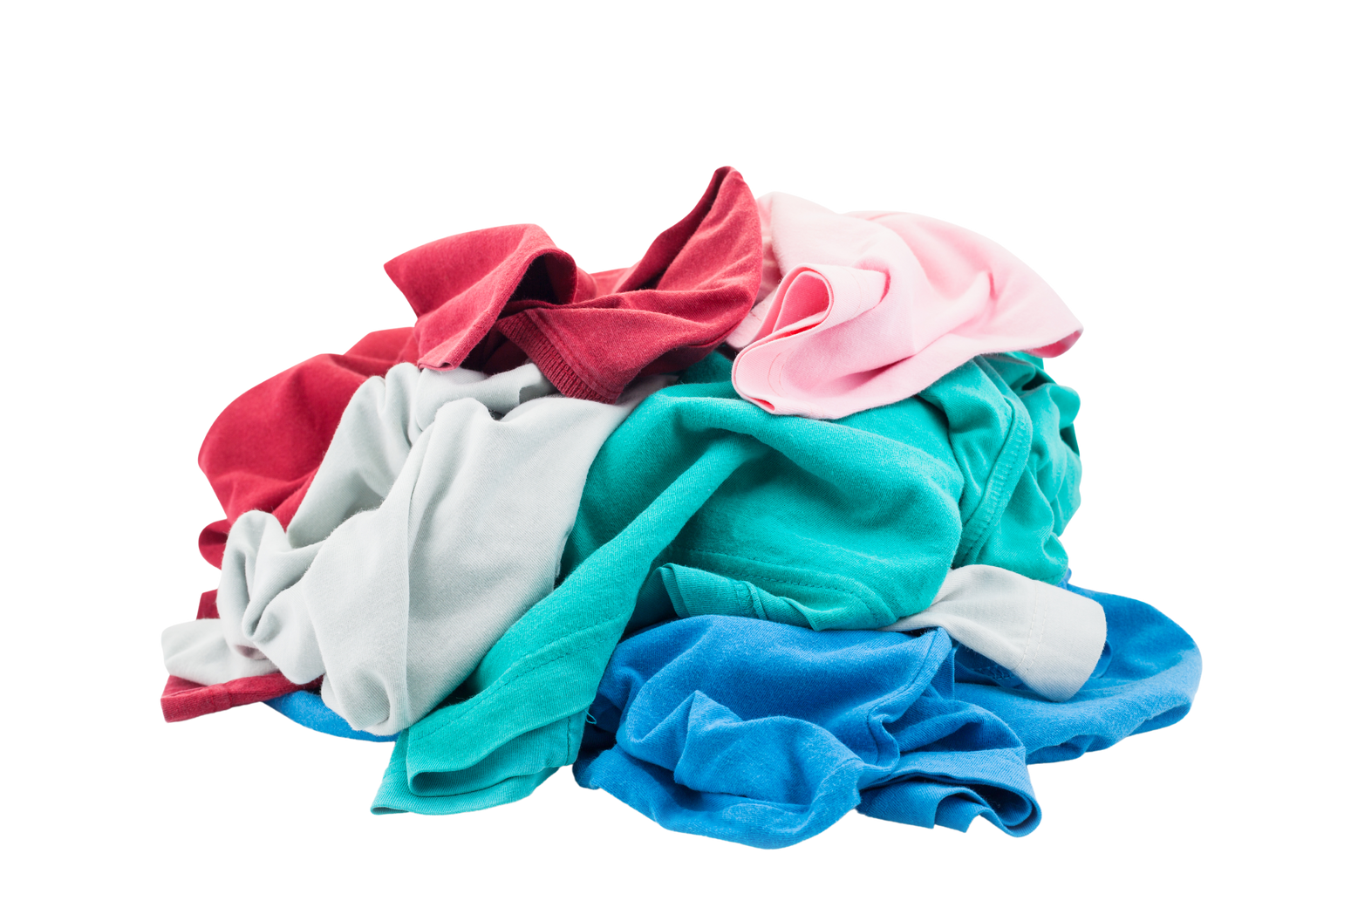

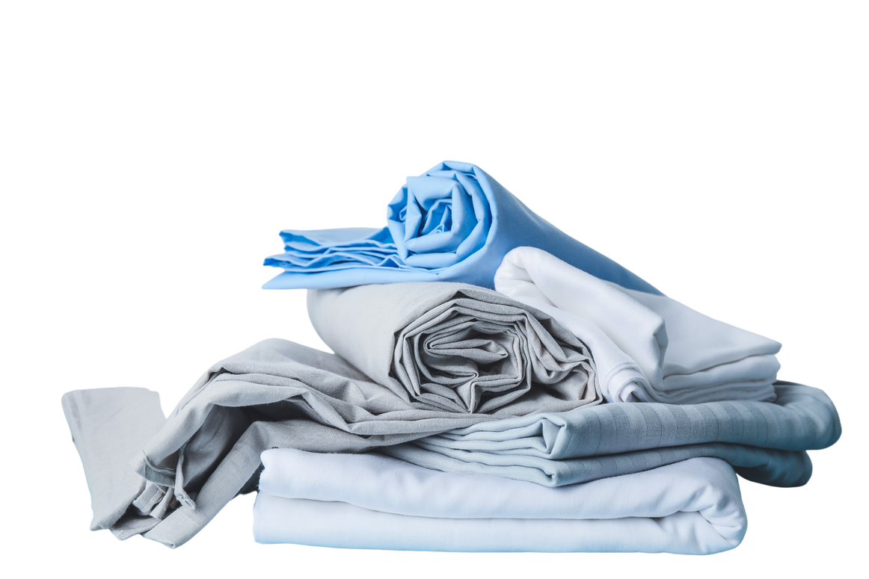
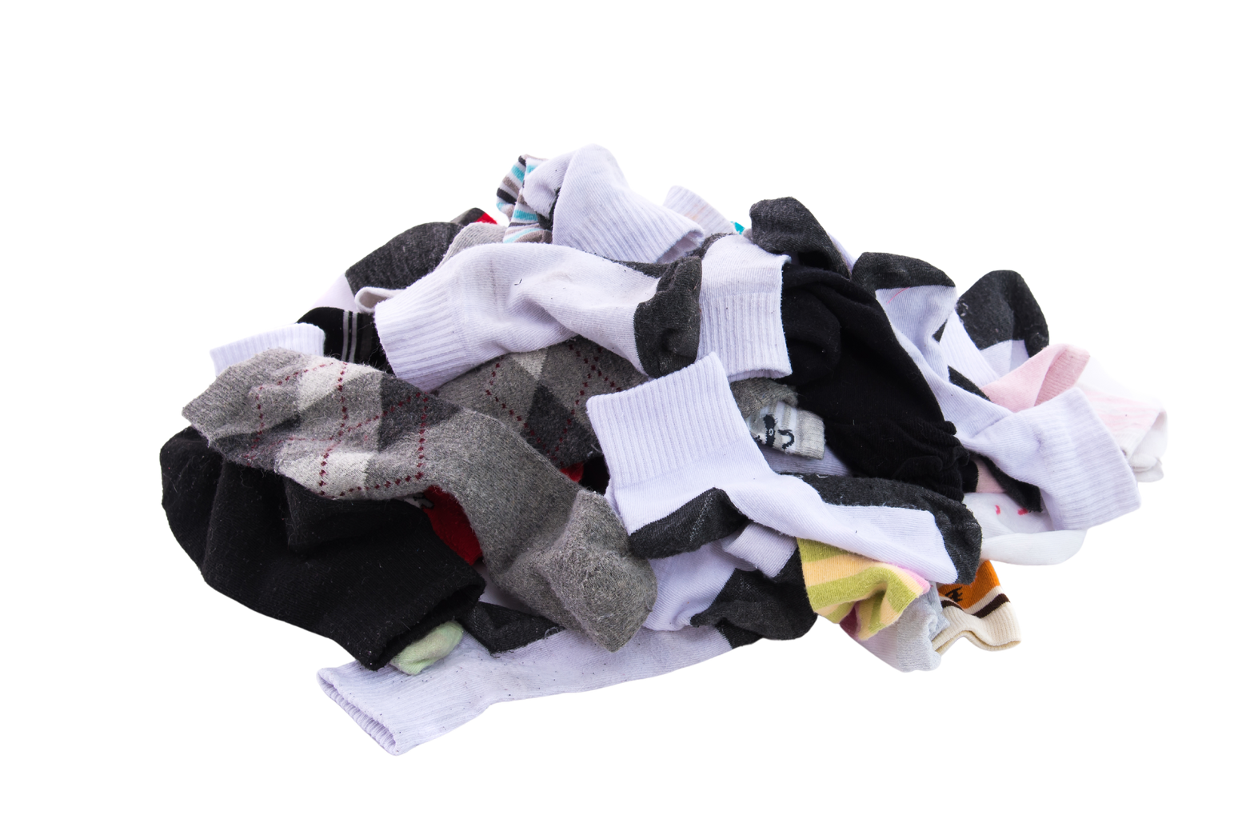
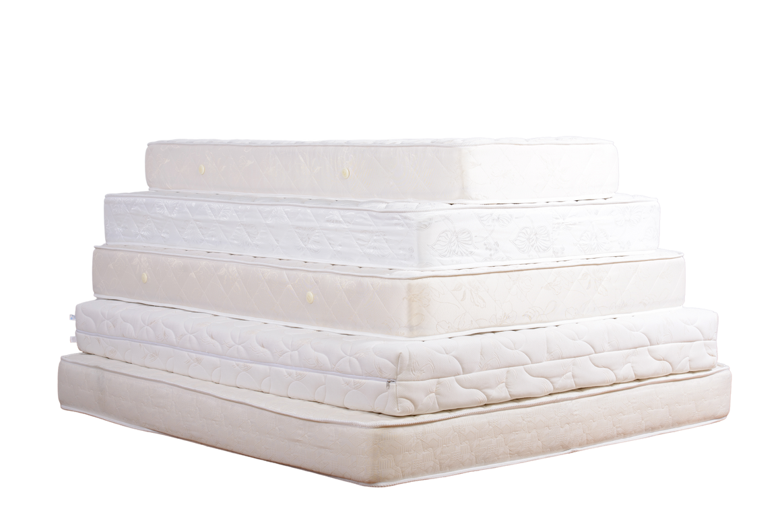
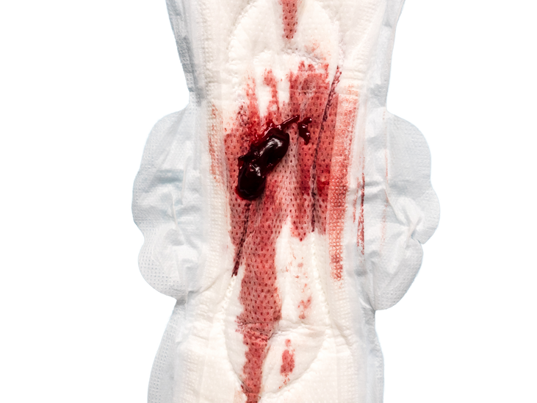
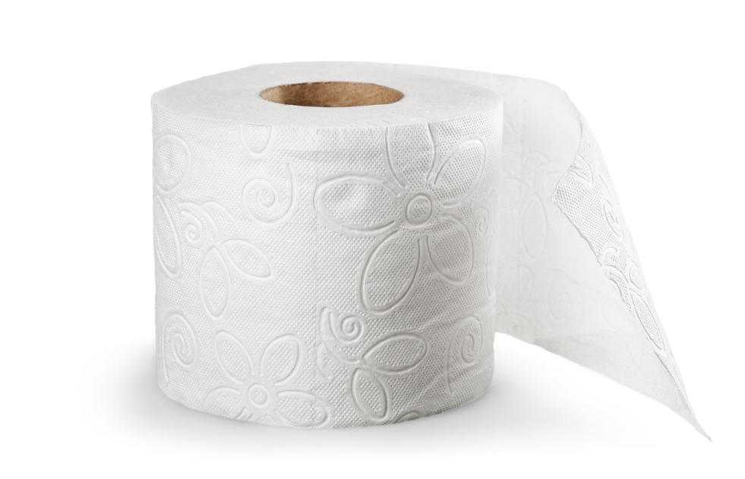
Part 2: Managing a Period While Incarcerated
EXAMPLES OF MENSTRUAL MITIGATION MEASURES USED IN
CORRECTIONAL FACILITIES
  Inserting mattress padding from a prison-issued mattress into the vagina
  Using day’s old tampons or sanitary pads beyond their effectiveness or vitality
  Using ripped bed sheets or cutting up old clothes to line in underwear
  Free-bleeding at bedtime
  Stacking multiple, super thin pads
  Creating “tampons” with pads
33

Slide 34
Part 2: Managing a Period While Incarcerated
REFLECTION QUESTIONS
What are some examples of Menstrual Mitigation Measures to manage a period?
How would more access to quality and sufficient period products impact incarcerated menstruators?
incarcerated people who menstruate are often forced to rely on ingenuity and creativity to manage their period.
8
34

Slide 35




Part 2: Managing a Period While Incarcerated
THE IMPACT OF EXPERIENCING PERIOD POVERTY AND USING MENSTRUAL MITIGATION MEASURES
Experiencing period poverty, and using Menstrual Mitigation Measures to manage a period impacts various aspect of people’s overall health, including:
Physical Health
Mental Health
Financial Stability
Self Dignity
35

Slide 36
Part 2: Managing a Period While Incarcerated
THE IMPACT OF USING MENSTRUAL MITIGATION EFFORTS
Physical Health
  Increased risks for reproductive infections, including Toxic Shock Syndrome, Sepsis, Emergency hysterectomy, and can lead to death
  Increased vulnerability for harmful physical and mental outcomes
  Fewer incarcerated women report infections when period products are available
20
38
Mental Health
  Lack of access to menstrual products is associated with poor self-esteem, shame, distress and a host of additional physical factors.
  Incarcerated people with periods may experience additional mental health concerns in addition to the psychological distress people already experience while incarcerated, because of period poverty
19
15
36

Slide 37
Part 2: Managing a Period While Incarcerated
THE IMPACT OF EXPERIENCING PERIOD POVERTY WHILE INCARCERATED
FINANCIAL STABILITY
  If the individual does not have sufficient funds to pay for period products while incarcerated, they often incur additional debt for themselves or their families
  Incurring debt to purchase period products while incarcerated adds to the Carceral Debt* they may already have incurred before, during, or after incarceration.
It is common for debt to follow people who have been impacted by incarceration.
*We will define Carceral Debt in the next slide
37

Slide 38
Part 2: Managing a Period While Incarcerated
CARCERAL DEBT:
21
Debt incurred from escalating incarceration fines and fees for things like:
  Court appearances, bail and probation costs
  “Room and Board,” and Child support orders
  Mandatory drug tests and Treatment fees
  Pre-trial debt, post-release debt
  Commissary debt from the need to purchase essential items, like menstrual products
22
Carceral Debt is further discussed in APPENDIX A: Carceral Debt
38

Slide 39
Part 2: Managing a Period While Incarcerated
“In Louisiana, incarcerated women might earn anywhere from 4 cents to $1 per hour.
Meanwhile, a pack of 20 cardboard-applicator tampons will cost them approximately $13 via prison commissary. A woman would need to work between 13 and 325 hours before she could afford a single box of tampons that might last through one period.”
- Gabrielle Perry
Executive Director, The Thurman Perry Foundation
“Opinion: In prison, having your period can put your life in danger.” The Washington Post
3
39

Slide 40
Part 2: Managing a Period While Incarcerated
THE IMPACT OF EXPERIENCING PERIOD POVERTY WHILE INCARCERATED
self dignity
  Menstrual health is a matter of health and human rights; yet, human rights among people that are incarcerated are often ignored.
  Lack of access to quality and sufficient menstrual products while incarcerated violates the Eighth Amendment of the US Constitution.
  Denial of basic life necessities can be considered cruel and unusual punishment.
23
24
40

Slide 41
Part 2: Managing a Period While Incarcerated
“Kimberly Haven, a formerly incarcerated woman, had to have an emergency hysterectomy due to toxic shock syndrome after using makeshift tampons in prison. She testified to Maryland legislators in support of a bill to provide menstrual products to incarcerated women and girls.
She asked her audience to imagine themselves in the place of those women, who would ‘refuse visits from family, [or] attorneys, because they’re embarrassed at having to … squat and cough — just to have the visit, and when you squat and cough … and there’s a bloody pad there and you have to throw it away, you now have to walk back to your pod with nothing there, running the risk of bleeding through your clothes, and you don’t have access to laundry facilities.”
- American Civil Liberties Union (ACLU)
The Unequal Price of Periods: Menstrual Equity in the United States
43
Lack of access to menstrual products can have devastating and permanent effects
41

Slide 42
Part 2: Managing a Period While Incarcerated
REFLECTION QUESTIONS
What questions or reflections do you have from this information so far?
How would providing access to menstrual products impact the quality of life for incarcerated menstruators?
“All prisoners shall be treated with the respect due to their inherent dignity and value as human beings.”
- The Office of the High Commissioner for Human Rights
Basic Principles for the Treatment of Prisoners
25
42

Slide 43
PERIOD PRODUCTS IN CORRECTIONAL FACILITIES
Part 2: Managing a Period While Incarcerated
43

Slide 44


Part 2: Managing a Period While Incarcerated
PERIOD PRODUCTS IN CORRECTIONAL FACILITIES
Only certain period products, and certain types of packaging, are allowed in correctional facilities.
Some period products are prohibited because correctional authorities outlaw any menstrual products or packaging that can be used to smuggle illicit drugs or other materials.
Other period products are just difficult to use while incarcerated, given the general limitations and security regulations in correctional facilities (as discussed in Part 1).
44

Slide 45




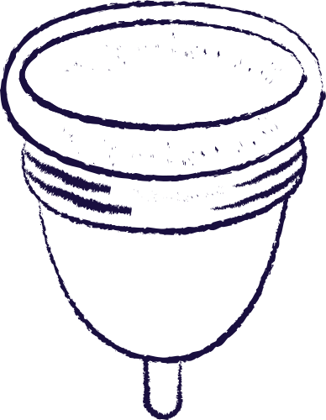
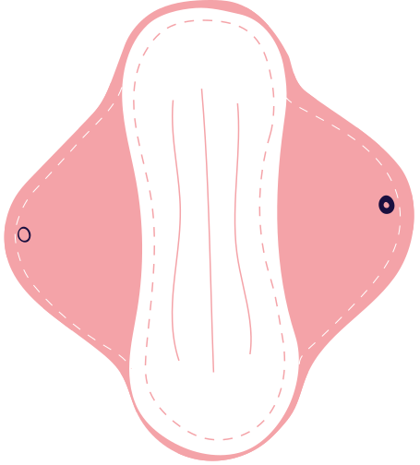
Part 2: Managing a Period While Incarcerated
PERIOD PRODUCTS IN CORRECTIONAL FACILITIES
TYPICALLY ALLOWED
TYPICALLY NOT ALLOWED
Disposable Pads
Disposable Pantyliners
Tampons**
Period Underwear
All sizes are typically welcomed!**
**If donating period products, check which products and packaging are allowed with the specific correctional facility.
Menstrual Cups
Reusable Pads / Pantiliners
45

Slide 46
Part 2: Managing a Period While Incarcerated
PERIOD PRODUCTS IN CORRECTIONAL FACILITIES
  Multiple sizes are welcome
  Extra disposable pads, and pantyliners can be used to clean and tidy personal space
Disposable Pads
Disposable Pantyliners
  Some facilities allow tampons, other facilities don’t
  In some cases, Tampon applicators have been used as a makeshift toy for personal pleasure, prohibiting them in some facilities
Tampons**
46

Slide 47

Part 2: Managing a Period While Incarcerated
PERIOD PRODUCTS IN CORRECTIONAL FACILITIES
TYPICALLY NOT ALLOWED (OR DIFFICULT TO USE)
  Menstrual cups are sometimes considered a security threat, or confiscated as contraband, because of the possibility of smuggling illicit drugs or other covered materials in the menstrual cup.
  Keeping menstrual cups sufficiently clean and disinfected to reuse would be incredibly difficult in a prison environment, regardless of what materials they are made of.
Menstrual Cups
47

Slide 48

Part 2: Managing a Period While Incarcerated
PERIOD PRODUCTS IN CORRECTIONAL FACILITIES
TYPICALLY NOT ALLOWED (OR DIFFICULT TO USE)
  Sometimes Individuals have been forced to wash underwear in the shower, and wear their wet underwear. Doing this with reusable period underwear, pads or pantyliners, could be unsafe (and uncomfortable).
  Keeping reusable period underwear, pads or pantyliners sufficiently clean and dry to reuse would be incredibly difficult in a prison environment, regardless of what materials they are made of.
19
Period Underwear
Reusable Pads / Pantiliners
48

Slide 49
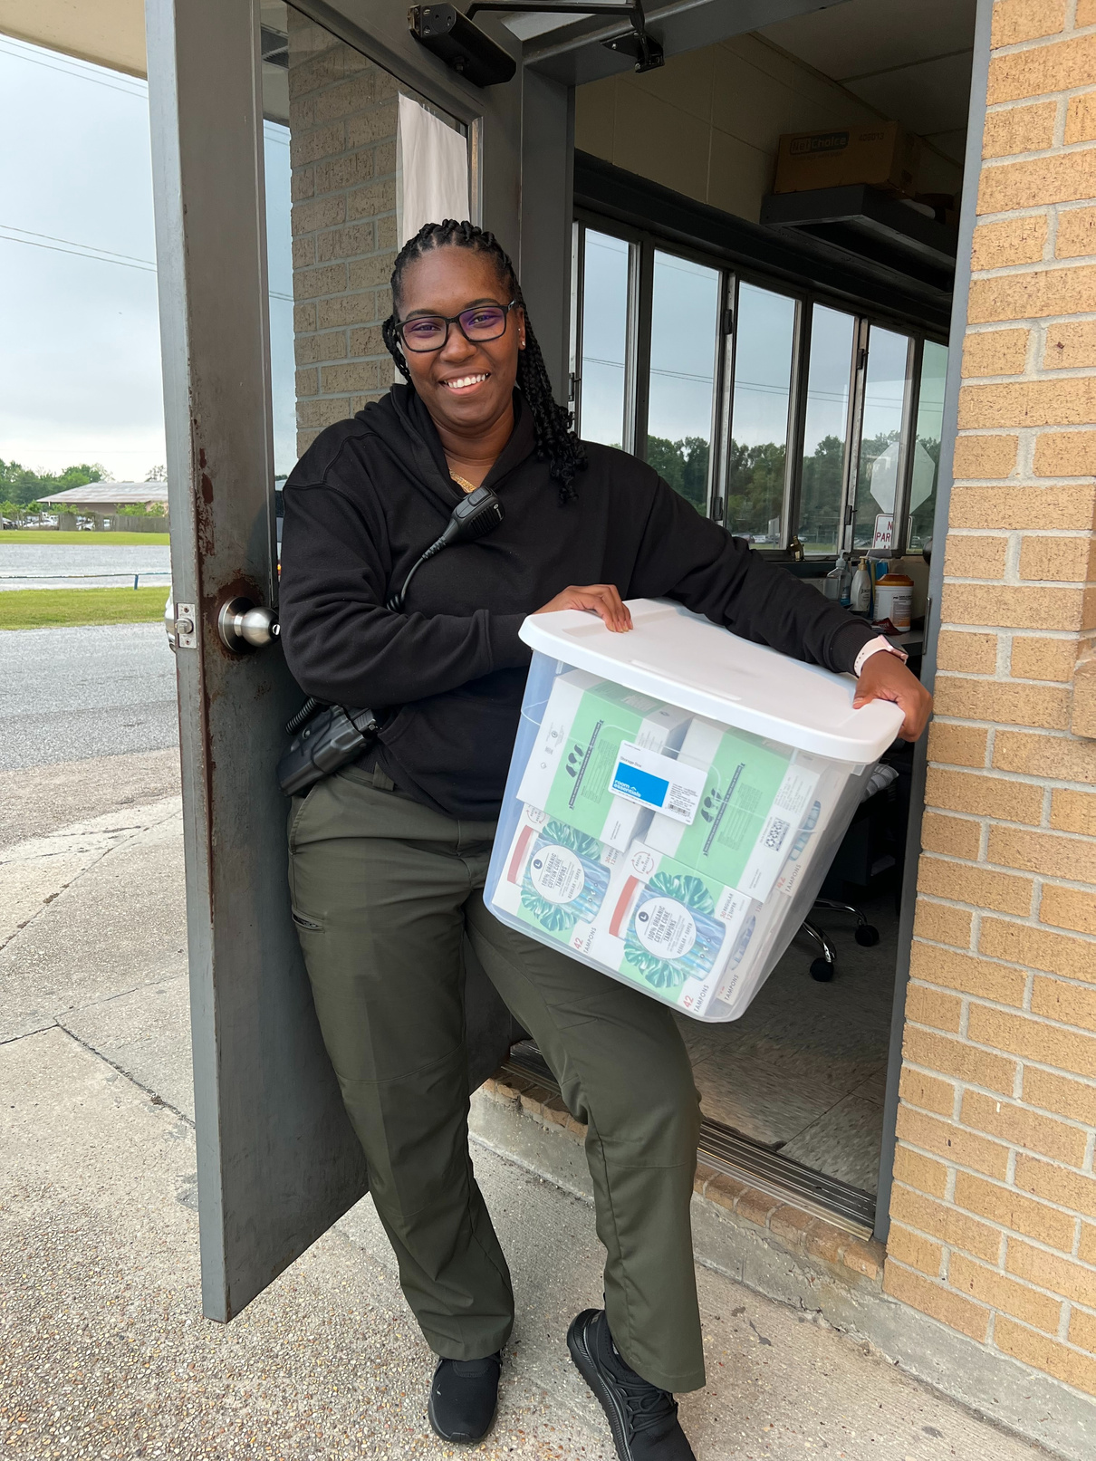
Part 2: Managing a Period While Incarcerated
PERIOD PRODUCTS IN CORRECTIONAL FACILITIES
**Policies and regulations for period products vary at each correctional facility.
If you would like to donate period products to a specific facility, it’s important to check which products and packaging are allowed with them directly.
Picture provided by The Thurman Perry Foundation
Disposable Pads
Disposable Pantyliners
Tampons**
49

Slide 50
Part 3: Menstrual Equity in Correctional Facilities
PERIOD POLICIES
IN PRISONS
50

Slide 51
Part 3: Menstrual Equity in Correctional Facilities
MENSTRUAL EQUITY:
The affordability, accessibility & safety of menstrual products for all people, including laws & policies that acknowledge & consider menstruation
26
51

Slide 52

Part 3: Menstrual Equity in Correctional Facilities
MENSTRUAL EQUITY IN STATE CORRECTIONAL FACILITIES
Colorado State Rep. Leslie Herod (D - CO) speaks on the Colorado State House, March 2019
CO HB 1224 was signed into law in April 2019, requiring Colorado jails to provide period products to people in custody at no expense to the inmates.
47
See the full video here: https://www.youtube.com/watch?v=4w_zqqTQkCw
52

Slide 53
Part 3: Menstrual Equity in Correctional Facilities
Menstrual Equity in Correctional Facilities
Period product requirements and enforcement are different at each facility, and depend on multiple factors, including:
  THE LOCATION: The specific policies related to the city, county, or state
  THE FACILITY TYPE: Jail, Detention Center, State or Federal Prison, etc.
  THE INDEPENDENT POLICIES: Each facility has unique policies, regulations, and oversight. There is no central governance for all correctional facilities.
If, when and how period products are distributed in correctional facilities can vary down to the discretion of the warden, and who is in charge of the facility’s regulations that day.
53

Slide 54
Part 3: Menstrual Equity in the U.S. Carceral System
“Adriene Kitcheyan, a woman formerly incarcerated in the Arizona Department of Corrections, testified to the Arizona legislature about her experience menstruating behind bars,
‘[b]loodstained pants, bartering, and begging for pads and tampons was a regular occurrence.”
- Amy Fetigg
Menstrual Equity, Organizing, and the Struggle for Human Dignity and Gender Inequality in Prison
COLUMBIA JOURNAL OF GENDER AND LAW
13
54

Slide 55
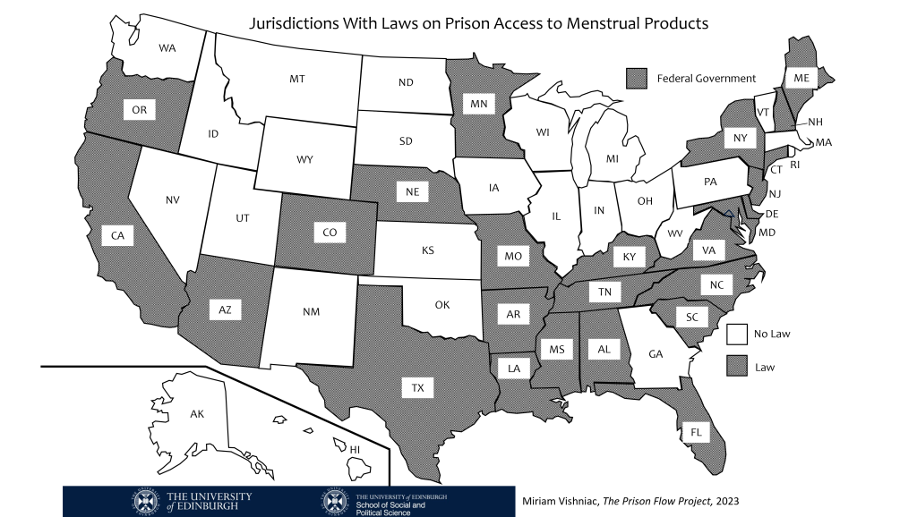
Part 3: Menstrual Equity in Correctional Facilities
27
States with laws ensuring some kind of access to menstrual products
What laws impact incarcerated menstruators in your state?
Image Source:
The Prison Flow Project,
2023
For an up to date list, see The Prison Flow Project’s State Policy Tracker
55

Slide 56
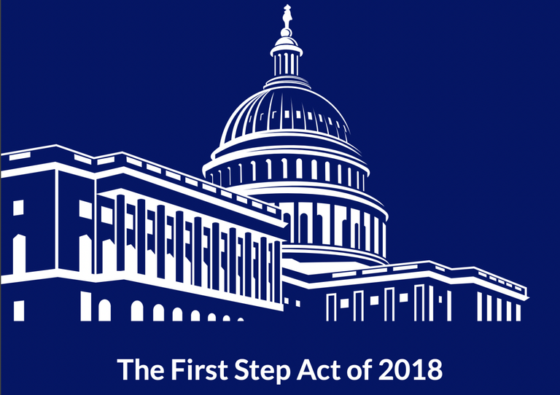
Part 3: Menstrual Equity in Correctional Facilities
ACCESS TO PERIOD PRODUCTS IN FEDERAL PRISONS
Image Source:
The Crime Report, 2023
In 2018, Congress passed the bipartisan First Step Act, a comprehensive criminal justice reform bill designed to aid and expand opportunities incarcerated individuals in the federal prison system.
The Prison Flow Project’s “Federal Prison Information” includes a comprehensive a list of Women’s Federal Prisons that explicitly mention the provision of menstrual products in their handbook.
28
29
30
56

Slide 57

Part 3: Menstrual Equity in the U.S. Carceral System
FEDERAL PRISON ACCESS TO PERIOD PRODUCTS
Under The First Step Act, the Federal Bureau of Prisons (BOP) is required to provide tampons and sanitary napkins that meet industry standards to incarcerated people in federal prisons for free, and in a quantity that meets the healthcare needs of each person.
28
Although this is a great “first step,” the vast majority of incarcerated women do not benefit from this, simply because most are in state and local facilities, not federal prisons.
31
57

Slide 58
Part 3: Menstrual Equity in the U.S. Carceral System
REFLECTION QUESTION
Once period products are required by law in correctional facilities, who is in charge of ensuring incarcerated menstruators receive the products they need?
“Laws DO NOT necessarily solve the issue of access to menstrual products in prison. State agencies and individual wardens frequently still have final say over what implementation and adherence looks like.”
- The Prison Flow Project
State Laws Around Menstrual Products in Prisons
27
8
58

Slide 59


Part 3: Menstrual Equity in the U.S. Carceral System
Menstrual Equity in Correctional Facilities
There are multiple reports of Incarcerated menstruators who subject themselves to sexual abuse, rape, and sexual assault in exchange for menstrual products.
32, 33
The American Civil Liberties Union (ACLU) sued correctional facilities and detention centers around the country to address the threat, violence and sexual assault impacting incarcerated menstruators.
34, 43
35
36
37
Example lawsuits include: Michigan, New Jersey, and Oregon.
59

Slide 60
Part 3: Menstrual Equity in the U.S. Carceral System
“If a woman needs more [period products] that’s been allocated for her, she might be able to buy products from the commissary - if she can afford it.
Otherwise, it’s likely up to guards to decide if they want to provide additional supplies, further reinforcing the unequal power structure and raising the risk of abuses.”
- Melissa Jetson
Senior Reporter, The Huffington Post
33
60

Slide 61




Part 3: Menstrual Equity in the U.S. Carceral System
Why is
MENSTRUAL EQUITY AN ISSUE
in U.S. Correctional Facilites?
Lack of Awareness
Punishment and Control
Little to No Budget Allocations
Little to No Accountability
61

Slide 62
Part 3: Menstrual Equity in the U.S. Carceral System
WHY IS MENSTRUAL EQUITY AN ISSUE IN CORRECTIONAL FACILITIES?
The general public has limited to no understanding of policies that impact how incarcerated people exist, particularly the experience of incarcerated women, girls and people who menstruate.
Being a part of today’s discussion is a great way to learn more!
Lack of Awareness
The female body and functions have been used as a method of control, breeding punishment, humiliation and torture for women, girls and people who menstruate both in and outside of correctionacl facilities.
Punishment and Control
32, 33
62

Slide 63

Part 3: Menstrual Equity in the U.S. Carceral System
WHY IS MENSTRUAL EQUITY AN ISSUE IN CORRECTIONAL FACILITIES?
There is often little to no funds allocated in a budget for period products in correctional facilities.
Little to No Budget Allocations
Although laws do exist in some states, there is limited to non-existent accountability for implementation and management of distributing period products in correctional facilities.
27
Little to No Accountability
It is often up to staff at each facility to determine the logistics of “when, how, what kind,” and “how many” period products to distribute.
63

Slide 64
Part 3: Menstrual Equity in the U.S. Carceral System
“In the last few years, states and localities have passed laws to ensure the provision of safe, affordable, or free menstrual products... But we are still at the beginning of this movement for menstrual equity.
The United States remains a country where menstruating is a liability for all and a weapon and instrument of control used against many, and where equality of opportunity and dignity for those who bleed is often undermined by law, policy and practice.”
- Amy Fetigg
Menstrual Equity, Organizing, and the Struggle for Human Dignity and Gender Inequality in Prison
COLUMBIA JOURNAL OF GENDER AND LAW
13
64

Slide 65
Part 2: Managing a Period While Incarcerated
REFLECTION QUESTIONS
What, if anything, has stood out the most to you from what we have discussed?
What questions or reflections do you have about Menstrual Equity in Correctional Facilities?
“The world is full of what seem like intractable problems. Often we let that paralyze us.
Instead, let it spur you to action.”
- Melinda French Gates
42
65

Slide 66


Part 4: Taking Action and Next Steps
WHAT CAN YOU DO?
TAKE ACTION THROUGH:
EDUCATION
SERVICE
ADVOCACY
66

Slide 67
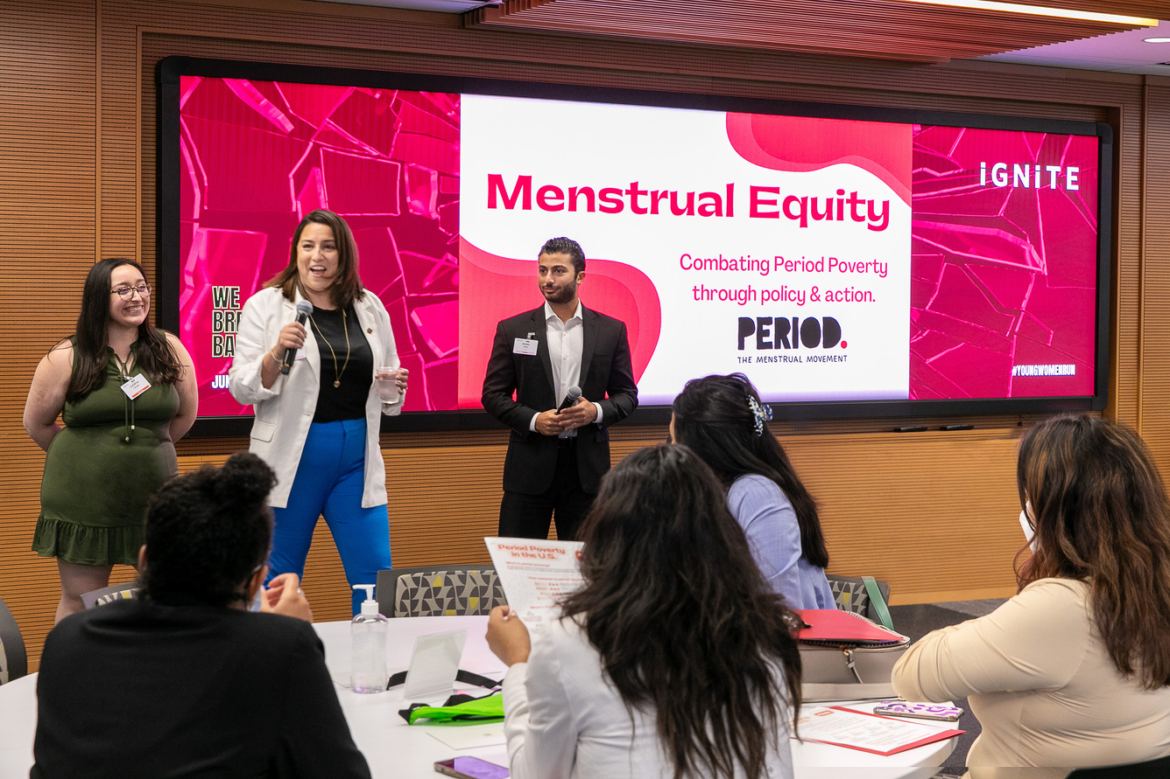
Part 4: Taking Action and Next Steps
TAKE ACTION THROUGH EDUCATION
TALK ABOUT PERIODS IN PRISONS
Share this information with your friends, family, colleagues, and network.
The more we talk about this issue, the less stigmatized this conversation will become.
This presentation can be shared widely!
For additional educational resources about period poverty, visit periodactionday.com/education
Photo Courtesy of IGNITE
67

Slide 68
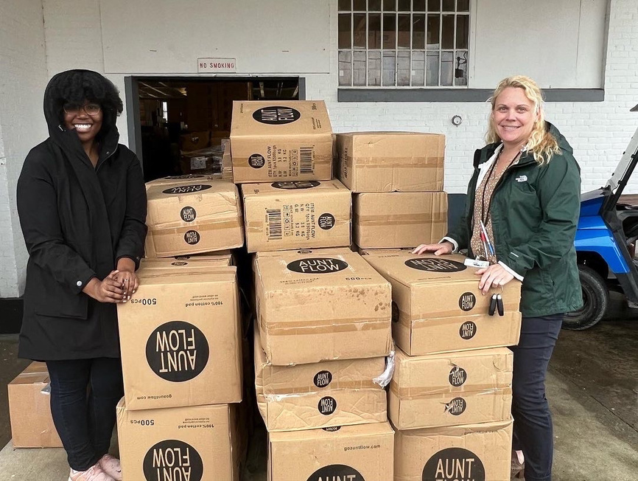
Part 4: Taking Action and Next Steps
TAKE ACTION THROUGH SERVICE
DONATE PERIOD PRODUCTS
Donate to organizations that distribute menstrual products to people impacted by incarceration﻿, like The Thurman Perry Foundation or PERIOD.
Contact a local correctional facility to discuss hosting a Period Product drive if they are in need of period products.
Photo Courtesy of The Thurman Perry Foundation
For additional resources about how to hose your own
period product drive, visit periodactionday.com/service
68

Slide 69
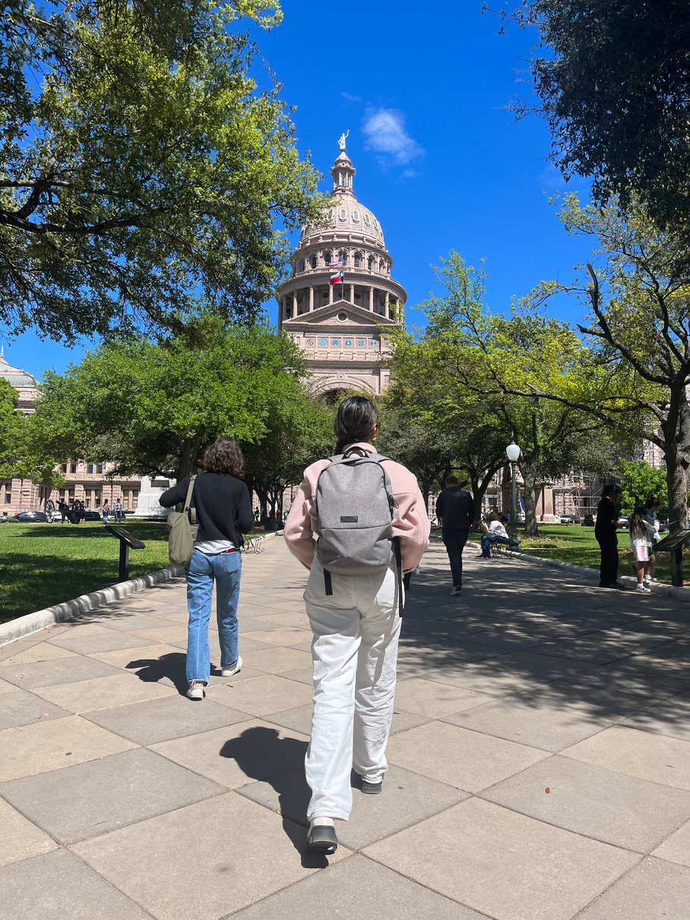
Part 4: Taking Action and Next Steps
TAKE ACTION THROUGH ADVOCACY
ADVOCATE FOR SYSTEMIC CHANGE
Know the menstrual equity bills and policies that impact your state’s correctional facilities
  The Prison Flow Project’s State Tracker
  The Prison Flow Project’s Federal Tracker
Contact your elected representatives and let them know why they should address this issue
  Find your elected officials here
For additional advocacy resources, visit periodactionday.com/advocacy
Photo Courtesy of PERIOD.
69

Slide 70

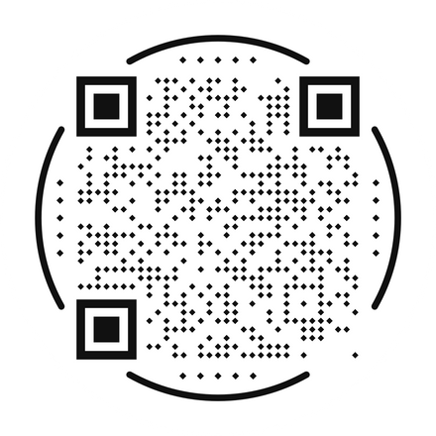
Part 4: Taking Action and Next Steps
THE MENSTRUAL EQUITY FOR ALL ACT OF 2023
The Menstrual Equity for all Act of 2023 (ME4ALL), introduced by Congresswoman Grace Meng (D -NY), is a federal bill, comprehensive whole-of-government approach to eradicate period poverty and achieve menstrual equity in the the United States.
If passed, incarcerated individuals and detainees in federal, state, and local facilities around the United States would have access to free menstrual products. The bill also includes a requirement for guidance on distribution.
Learn more about the Menstrual Equity For All Act of 2023
TAKE ACTION TO SUPPORT THIS BILL RIGHT NOW!
46
Courtesy of IGNITE
40
70

Slide 71
Part 4: Taking Action and Next Steps
CLOSING REFLECTIONS
What are 1-2 facts or statistics that that stood out to you from today’s discussion?
What are some ways you can take action through through Education, Service or Advocacy?
Thank you! We hope this discussion is the start of a deeper conversation about periods in prisons, not the end.
Check out our APPENDICES to learn more!
71

Slide 72
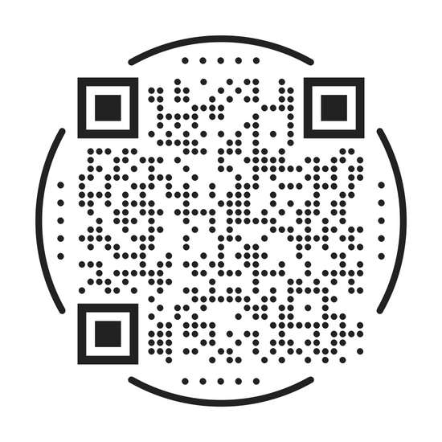

PERIODS IN PRISON: A 4-Part Workshop about Period Poverty and Menstrual Equity in U.S. Correctional Facilities
Stay Connected with us!
Share your reflections and feedback:
PERIOD.
www.period.org | www.periodactionday.com
@Periodmovement
The Thurman Perry Foundation
www.ThurmanPerryFoundation.org
@ThurmanPerryFoundation
We have a comprehensive reference list and additional readings to learn more!
A: Carceral Debt
B: Policy Recommendations
C: References
D: Additional Readings
APPENDICES:
“Periods in Prison” by PERIOD. and the Thurman Perry Foundation is licensed under the Creative Commons Attribution-NonCommercial-ShareAlike 4.0 International License. To view a copy of this license, visit http://creativecommons.org/licenses/by-nc-sa/4.0/

Slide 73
APPENDIX A: Carceral Debt
Incarcerated menstruators may incur additional debt to purchase period products while incarcerated, which adds to the Carceral Debt they may already have incurred.
As discussed in Part 2 of this presentation.
Women are being incarcerated in local jails at alarming rates around the U.S. because they often cannot afford to pay government fines, fees, and bail. Incarceration is increasing because of the criminalization of poverty at the local level.
Carceral debt is accompanied with incarceration at any level, can be incurred from pre-trial debt, commissary debt, escalating fines and fees, or post-release debt
  Pre-trial debt affects women primarily because the majority of women in local jails are legally innocent, and they cannot be sentenced, adding additional costs
  Carceral Debt continues to increase from pre-trial diversion programs, required family planning classes, commissary debt, escalating fines and fees, and Pay Day Loans offered to pay for such expenses, only increasing debt, and ranging from hundreds to thousands of dollars.
31
Learn more about Carceral Debt from The Debt Collective
21
73

Slide 74
appendix b: Policy RecomMendations
Page 1 of 2
General Security Regulations:
  Consider eliminating legal penalties for free-bleeding or sharing of menstrual products
  Consider the needs of menstruators within the context of how all “security regulations” impact incarcerated people who menstruate
Product Choice and Access:
  Providing period product choice can become a tool for enhancing women’s agency and can improve menstrual health.
  Consider increasing period product choice, and offering various sizes to address the differences in menstrual flow
  Provide a clear course of action for incarcerated menstruators to report any discrimination, abuse or harassment experienced in exchange for menstrual products
See Menstrual Equity: A Legislative Toolkit from the ACLU for Model Legislation (Page 20)
44
74

Slide 75
appendix b: Policy RecomMendations
Page 2 of 2
Menstrual Health and Safety:
  Consider including healthcare professionals on determining which government-issued menstrual products are distributed in correctional facilities, to increase safety and effectiveness.
  Consider increasing access to timely and preventative healthcare screenings, along with pain management, diagnosis and treatment for Heavy Menstrual Bleeding Disorders like Fibroids, PCOs, or Endometriosis
Increased Access + Accountability:
The state of NY not only requires menstrual products in their correctional facilities, but the NY City Council introduced an amendment that would require the Department of Correction (DOC) to report on its distribution of menstrual product, increasing accountability.
We are hopeful to see similar policies introduced, and passed, in states around the country.
See Menstrual Equity: A Legislative Toolkit from the ACLU for Model Legislation (See Page 20)
44
75

Slide 76
appendix C: References
1. Facts about the over-incarceration of women in the United States. American Civil Liberties Union. (2007, December 12). https://www.aclu.org/documents/facts-about-over-incarceration-women-united-states
2. Norwood, C. (2021, October 5). More women are serving life sentences. Experts want to know why. The 19th. https://19thnews.org/2021/10/more-women-are-serving-life-sentences-why/
3. Perry, G. A. (2022, March 30). Opinion: In prison, having your period can put your life in danger. The Washington Post. https://www.washingtonpost.com/opinions/2022/03/25/prison-period-danger-health-risks-sexual-abuse/
4. Hehir, I. (2019, May 27). Why we need to rethink the way we view periods. UNICEF Australia.
5. World Bank Group. (2018, June 7). Menstrual hygiene management enables women and girls to reach their full potential. World Bank. https://www.worldbank.org/en/news/feature/2018/05/25/menstrual-hygiene-management
6. Rossouw, L., & Ross, H. (2021). Understanding Period Poverty: Socio-Economic Inequalities in Menstrual Hygiene Management in Eight Low-and Middle-Income Countries. International Journal of Environmental Research and Public Health, 18(5), 2571. AND Vora, S. (2020). The realities of period poverty: how homelessness shapes women’s lived experiences of menstruation. The Palgrave handbook of critical menstruation studies, 31-47.
7. Thinx & PERIOD. (2021). State of the period 2021. https://period.org/uploads/State-of-the-Period-2021.pdf
8. U by Kotex Period Poverty Awareness Week – Survey Results (2021) https://allianceforperiodsupplies.org/wp-content/uploads/2022/05/U_by_Kotex_Period_Poverty_-_PPAW_Data_Set.pdf
9. Cardoso, L. F., Scolese, A. M., Hamidaddin, A., & Gupta, J. (2021). Period poverty and mental health implications among college-aged women in the United States. BMC Women's Health, 21(1), 1-7 https://bmcwomenshealth.biomedcentral.com/articles/10.1186/s12905-020-01149-5
76

Slide 77
appendix C: References
10. Definition: Correctional facility from 34 USC § 10651(l)(1). Legal Information Institute. (n.d.). https://www.law.cornell.edu/definitions/uscode.php?width=840&height=800&iframe=true&def_id=34-USC-1339097894-1337661723&term_occur=999&term_src=title%3A34%3Asubtitle%3AI%3Achapter%3A101%3Asubchapter%3AXXXIII%3Asection%3A10651#:~:text=(1)%20Definitions%20(A),justice%20agency%20or%20a%20court.
11. United States profile. United States profile | Prison Policy Initiative. (2023). https://www.prisonpolicy.org/profiles/US.html
12. Monazzam, N. (2023, March). Incarcerated women and girls. The Sentencing Project. https://www.sentencingproject.org/app/uploads/2023/05/Incarcerated-Women-and-Girls-1.pdf
13. Fettig, A. (n.d.). View of Menstrual Equity, Organizing and the Struggle for Human Dignity and Gender Equality in Prison: Columbia Journal of Gender and Law. https://journals.library.columbia.edu/index.php/cjgl/article/view/8823/4563
14. Maranze, M. (2015, February 4). Pathology of the carceral state. Los Angeles Review of Books. https://lareviewofbooks.org/article/pathology-carceral-state/
15. Kajstura, A., & Sawyer, W. (2023, March 1). Women’s mass incarceration: The whole pie 2023. Prison Policy Initiative. https://www.prisonpolicy.org/reports/pie2023women.html
16. Nelson, C. (2022, December 30). Jail vs. prison vs. detention center. University of Phoenix. https://www.phoenix.edu/blog/jail-vs-prison-vs-detention-center.html
17. FAQ: What is the difference between jail and prison?. Prison Fellowship. (2022, December 5). https://www.prisonfellowship.org/resources/training-resources/in-prison/faq-jail-prison/
18. Norwood, C. (2023, March 18). Comprehensive report shows the Disparities Incarcerated Women Face. The 19th. https://19thnews.org/2023/03/prison-policy-report-incarceration-women-disparities/
77

Slide 78
appendix C: References
19. Moss, Fenn, Vilches (2023) American Public Health Association. The Menstruating Body in US Carceral Facilities: What 3 Women in Alabama Reveal about Misdirection in the Menstrual Equity Space
20. Rapp, A., & Kilpatrick, S. (2020, February 4). Changing the Cycle: Period Poverty as a Public Health Crisis. University of Michigan School of Public Health﻿. https://sph.umich.edu/pursuit/2020posts/period-poverty.html
21. Carceral Debt. Debt Collective. (2023, September 25). https://debtcollective.org/what-we-do/campaigns/carceral-debt/#:~:text=Time%20in%20jail%20and%20prison,we%20call%20%E2%80%9Ccarceral%20debt.%E2%80%9D
22. Roman, C. G. (2015, February 26). Child Support, Debt, and Prisoner Reentry: Examining the Influences of Prisoners’ Legal and Financial Obligations on Reentry. Office of the Justice Programs. https://www.ojp.gov/pdffiles1/nij/grants/248906.pdf
23. Babbar, Karan. (2021, October 27). Menstrual Health is a public health and human rights issue. The Lancet. https://www.thelancet.com/journals/lanpub/article/PIIS2468-2667(21)00212-7/fulltext
24. Fettig, A. (n.d.). View of Menstrual Equity, Organizing and the Struggle for Human Dignity and Gender Equality in Prison: Columbia Journal of Gender and Law. https://journals.library.columbia.edu/index.php/cjgl/article/view/8823/4563
25. General Assembly Resolution. (1990, December 14). Basic Principles for the Treatment of Prisoners. Universal Instruments. https://www.ohchr.org/en/instruments-mechanisms/instruments/basic-principles-treatment-prisoners#:~:text=All%20prisoners%20shall%20be%20treated,property%2C%20birth%20or%20other%20status.
26. Weiss-Wolf, J. (2017). Periods gone public: Taking a stand for menstrual equity. Simon and Schuster
27. State laws around access. The Prison Flow Project. (2023b, August 18). https://theprisonflowproject.com/state-laws-around-access/
78

Slide 79
appendix C: References
28. An Overview of the First Step Act. Federal Bureau of Prisons. (n.d.). https://www.bop.gov/inmates/fsa/overview.jsp#:~:text=The%20First%20Step%20Act%20requires,needs%20and%20reduce%20this%20risk
29. Nellis, A., & Komar, L. (2023, August 22). The First Step Act: Ending Mass Incarceration in Federal Prisons. The Sentencing Project. https://www.sentencingproject.org/policy-brief/the-first-step-act-ending-mass-incarceration-in-federal-prisons/
30. Federal Prison Information. The Prison Flow Project. (2023a, May 31). https://theprisonflowproject.com/federal-prison-information/
31. Samant, A. (2023, February 27). The first step act is a small step for incarcerated women: ACLU. American Civil Liberties Union. https://www.aclu.org/news/prisoners-rights/first-step-act-small-step-incarcerated-women
32. In the media. The Prison Flow Project. (2021, July 30). https://theprisonflowproject.com/media-coverage-by-state/
33. Jeltsen, M. (2016, June 23). Providing free pads and tampons to incarcerated women is about more than hygiene. HuffPost. https://www.huffpost.com/entry/new-york-prisons-periods_n_576bfcade4b0b489bb0c901b
34. Ransom, J. (2018, December 14). She says Rikers Guards raped her, then warned: “this never happened.” The New York Times. https://www.nytimes.com/2018/12/14/nyregion/rikers-rape-guards-federal-lawsuit.html
35. ACLU of Michigan Sues Muskegon County Over Unconstitutional Policies, Hazardous Conditions at Jail. ACLU of Michigan. (2018, October 31). https://www.aclumich.org/en/press-releases/aclu-michigan-sues-muskegon-county-over-unconstitutional-policies-hazardous
36. ACLU. (2008, July 25). Violation of Incarcerated Women’s Civil Rights in New Jersey. American Civil Liberties Union. https://www.aclu.org/documents/violation-incarcerated-womens-civil-rights-new-jersey
79

Slide 80
appendix C: References
37. ACLU. (2016, October 17). ACLU Sues Oregon Department of Corrections Officials Over Denial of Medical Care to Transgender Prisoner. American Civil Liberties Union. https://www.aclu.org/press-releases/aclu-sues-oregon-department-corrections-officials-over-denial-medical-care#:~:text=EUGENE%2C%20Ore.,being%20denied%20essential%20medical%20care.
38. Manley, E., & Held, K. S. (2023, July 4). Fewer incarcerated women report infections due to free tampons, pads. FOX 2 Now. https://fox2now.com/news/missouri/fewer-incarcerated-women-report-infections-due-to-free-tampons-pads/
39. Dholakia, N. (2021, May 17). Women’s incarceration rates are skyrocketing. These advocates are trying to change that. Vera Institute of Justice. https://www.vera.org/news/womens-incarceration-rates-are-skyrocketing
40.Congresswoman Grace Meng. (2023, August 23). Meng Introduces Whole-Of-Government Approach To Combat Period Poverty And Improve Access To Menstrual Products. House.gov. http://meng.house.gov/media-center/press-releases/meng-introduces-whole-government-approach-combat-period-poverty-and
41. Madami, PERIOD., Myovant Sciences, & Pfizer. (2022, January). Glossary for the Global Menstrual Movement. PERIOD. https://period.org/uploads/Global-Glossary-for-the-Menstrual-Movement-v1.3.pdf
42. Fakomogbon, G. (2022, June 7). 27 Inspirational Quotes About Activism From Some of the World’s Leading Activists. Global Citizen Life. https://www.globalcitizen.org/en/content/inspirational-quotes-activism-activist-leaders/
43. The unequal price of periods. American Civil Liberties Union. (n.d.) https://www.aclu.org/report/unequal-price-periods
44. Ruth, S., Ruth, M., Sarah, W., Matza, E., & Sara, C. (2019, December). Menstrual Equity- A Legislative Toolkit . https://www.aclu.org/wp-content/uploads/legal-documents/121119-sj-periodequitytoolkit.pdf
45. Sawyer, W. (2019, July 19). Who’s helping the 1.9 million women released from prisons and jails each year? Prison Policy Initiative. https://www.prisonpolicy.org/blog/2019/07/19/reentry/
80

Slide 81
appendix C: References
46. Advocate. National: Support Menstrual Equity For All Act of 2023 IGNITE. (n.d.). https://ignitenational.org/advocacy2021#/
47. HB19-1224: Free Menstrual Hygiene Products In Custody. Colorado General Assembly. (2019, April 25). https://leg.colorado.gov/bills/hb19-1224
appendix b: additional readings
Babbar, Karen. (2019, March 19). Inclusion means everyone: standing up for transgender and non-binary individuals who menstruate worldwide. The Lancet. https://www.thelancet.com/journals/lansea/article/PIIS2772-3682(23)00037-9/fulltext
CBS News. (2019). Activist, former inmate says there’s no reliable access to feminine hygiene products in prison. Retrieved 2023, from https://www.youtube.com/watch?v=-GWQayltLBE.
Murrell, I. C. (2023, August 29). Jefferson County sheriff calls for reimbursement from judge for hygiene product purchases. Arkansas Online. https://www.arkansasonline.com/news/2023/aug/29/jefferson-county-sheriff-calls-for-reimbursement-from-judge-for-hygiene-product-purchases/
81

